Slide 1
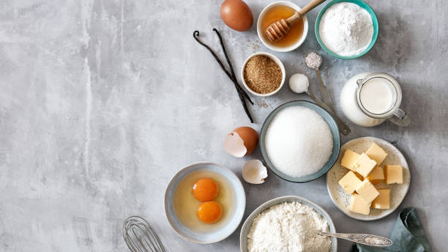

Slide 2

Past & Future

Slide 3
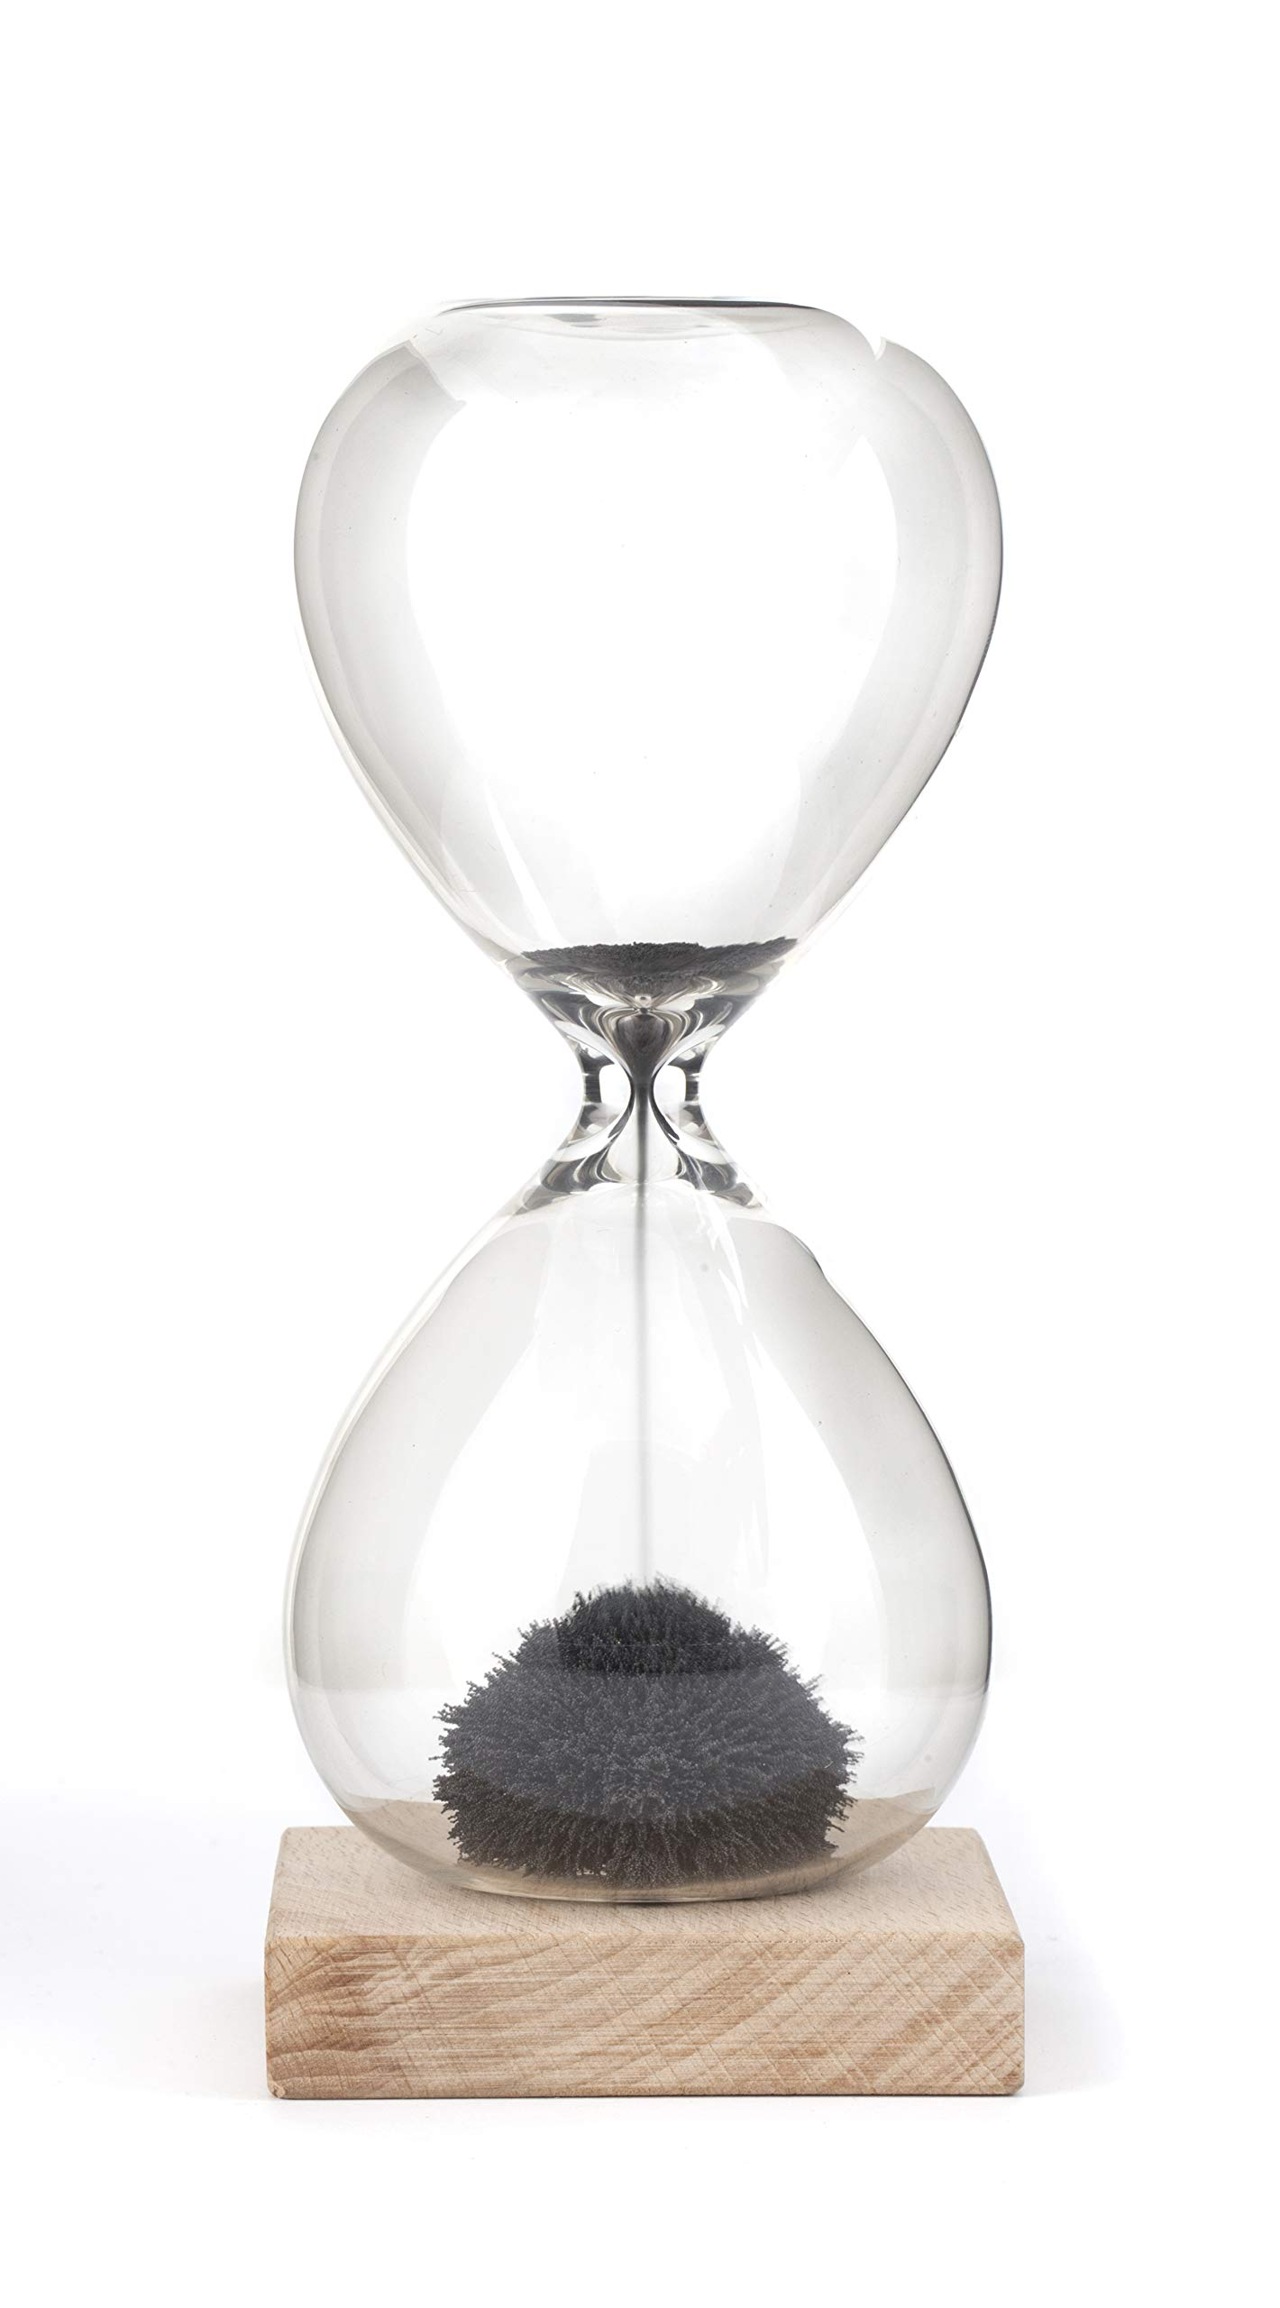

Slide 4

Techniques & Tools

Slide 5


Slide 6

Technology & Collaboration

Slide 7


Slide 8
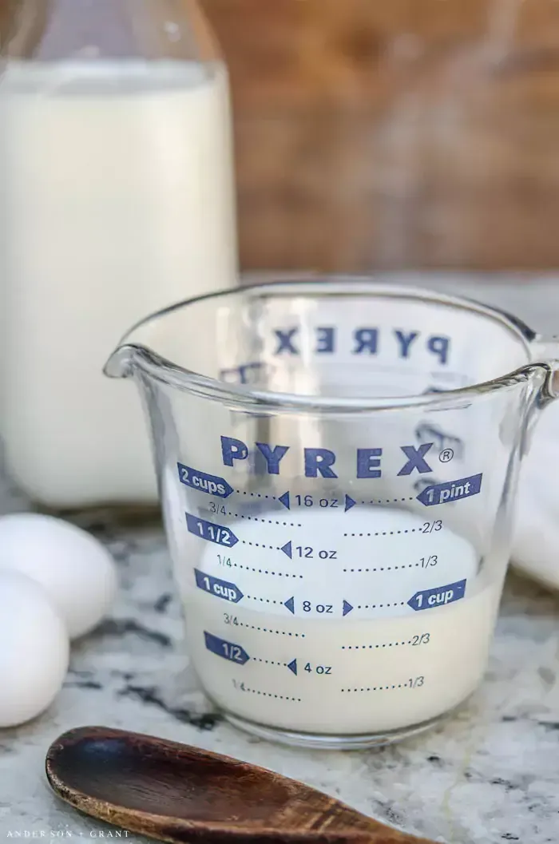

Slide 9
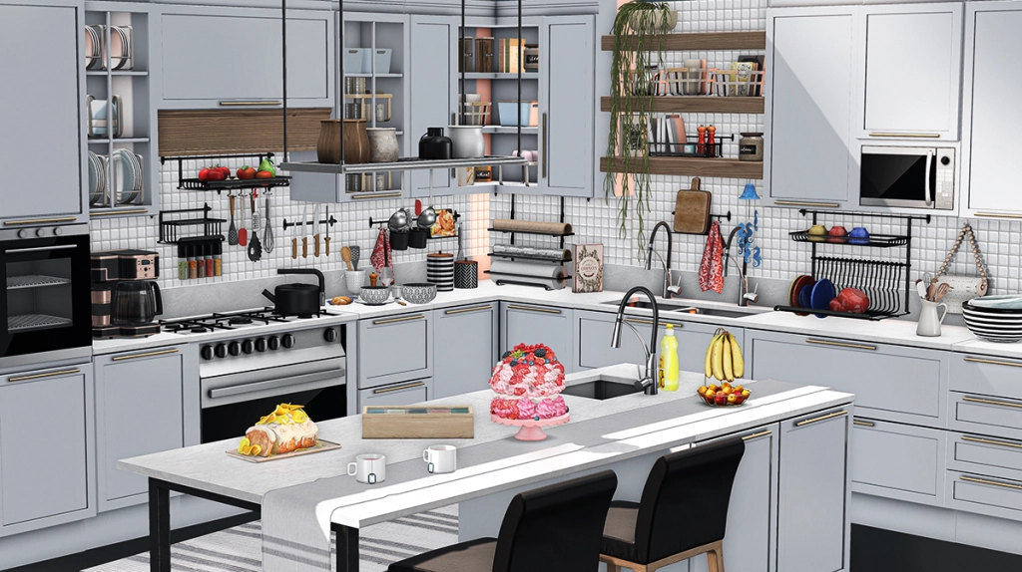

Slide 10
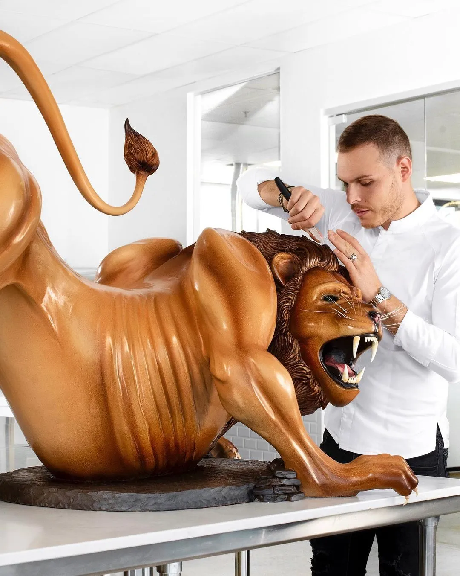
(The lion’s made of chocolate!)

Slide 11


Slide 12
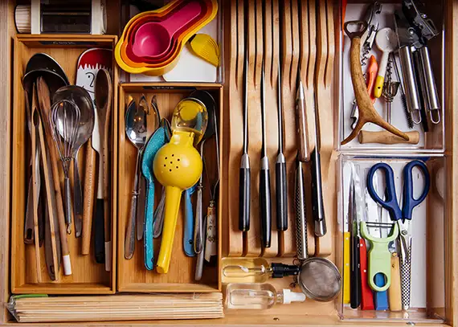
Disclaimer: This isn’t my drawer.

Slide 13
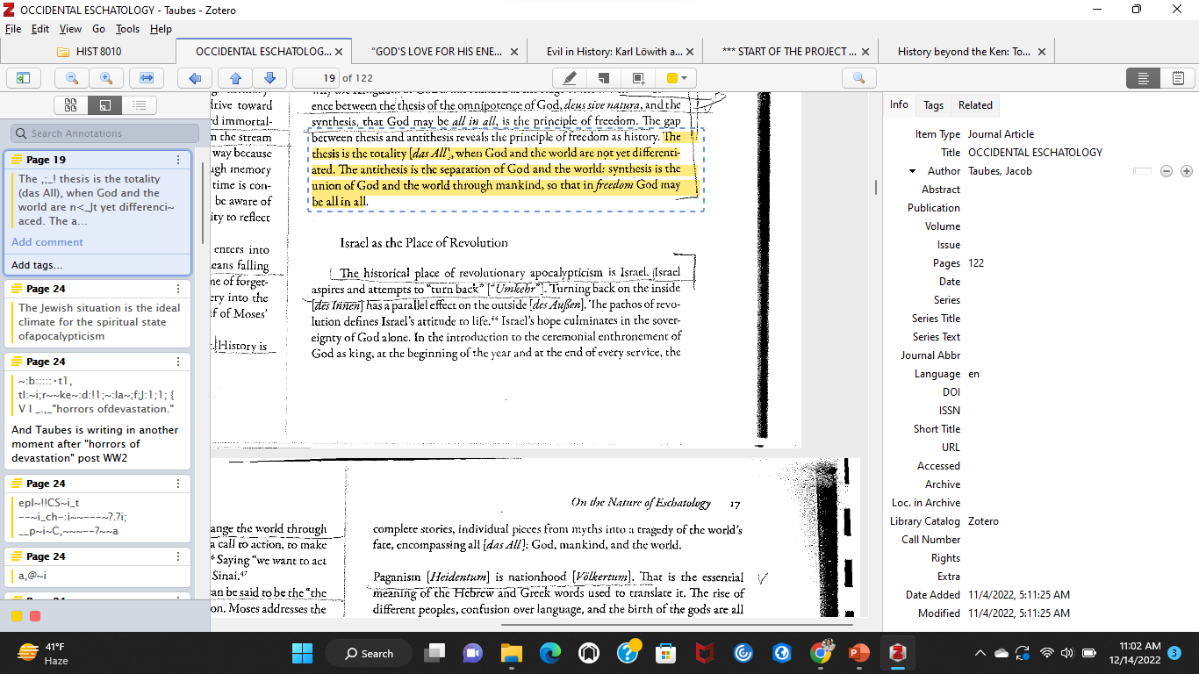
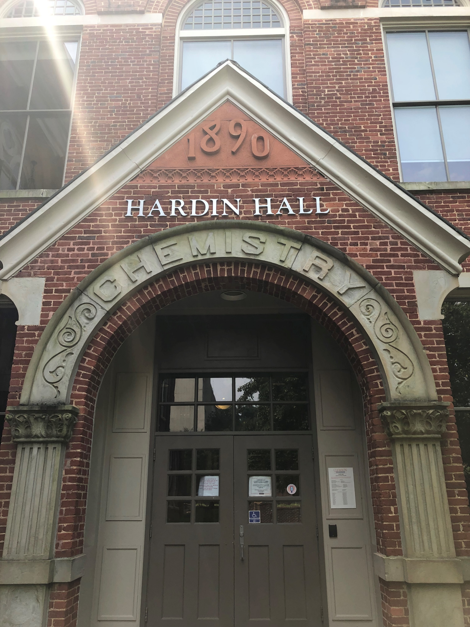
Zotero…Citations Simplified

Slide 14


Slide 15
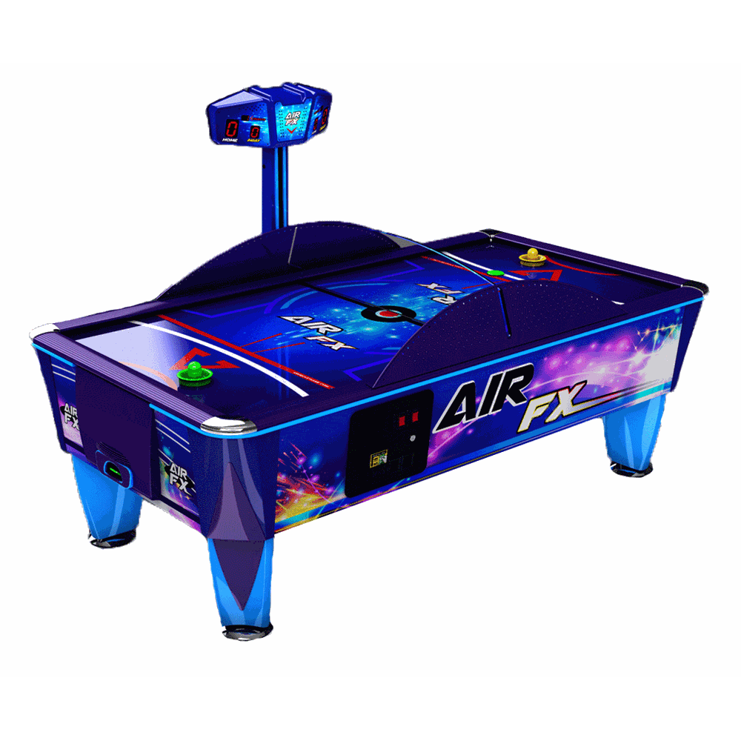

Slide 16


Slide 17

Authors
Merchants
Ingredients
Publishers
Farmers

Slide 18
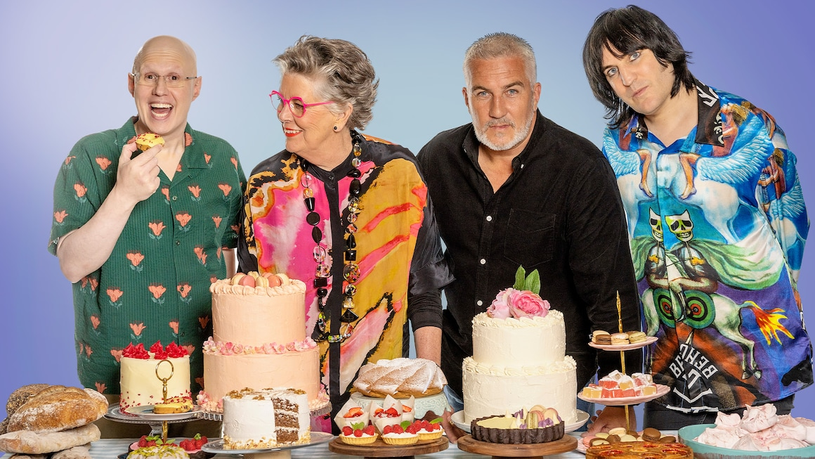
Spoiler Alert: Syabira won

Slide 19
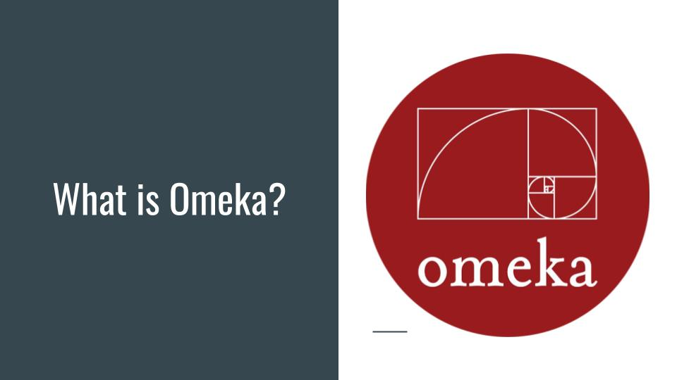

Slide 20
